Slide 1


WATER AND ELECTRICITY
HACKWORLD
Urbanize Away
Team Members:
S.R Calvin Davis
Anush Varath S
Ben stanes
Aravind
ElectroPyro_Robo_Trix

Slide 2
Overview
Most of the people in residential areas face the problem of running out of water and overflow of water in water tanks due to excess supply of water.
It becomes difficult for users to judge the level of water in water tanks, due to which at times of need users may run out of water.
Even when the pump is turned on users will not realize when the water tank is filled which may result in overflow.
Water monitoring system is used to sort out the issues associated with water tank.
It is also possible to check the level of the water using sensor so that whenever the water goes below certain threshold limit, then there the user will be notified with a pop-up message and the motor will be turned on automatically.
Also when there is overflow of water in water tank it uses sensor to detect the water level so that if the water level goes above certain limit the motor gets turned off automatically.
This system prevents wastage of water.

Slide 3

About The problem:
The total amount of water available on earth has been estimated as 1.4 billion cubic kilometers , about 95% of the Earth’s water is unfit for human consumption. About 4% is locked in the polar ice caps, and the rest 1% constitutes all fresh water found in rivers, streams and lakes which is suitable for our consumption.
The water is wasted at each and every outlet knowingly or unknowingly which adds up to huge amount in the end and about 50% of water supplied to the cities gets wasted through its improper usage.
Wasting waters may limit its availability to other communities , especially in areas where water shortage is common , this wasted water could have been used elsewhere.
These causes off wasting of water would make the few drastic consequences which includes rising costs , reduced food supplies due to the less yield, health hazards , and political conflicts.
Wasting water is also an economical burden . It takes many resources and processes to purify and make water potable.

Slide 4
Purpose:
In many houses there is unnecessary wastage of water due to overflow in overhead tanks.
The working of water level monitoring & controlling system is very easy.
A water level controller is a device that manages water levels in water tanks, pumps, and for
filling any type of liquid in the tank.
Basic function of a water level controller is to limit the water wastage & protect against
unnecessary electricity usage.
This is because level of water is controlled automatically, which limits the amount
of electricity used.
As a result less water and electricity is used to regulate water supply.

Slide 5
Problem statement:
Need of this system is to avoid wastage of water.
Sometimes people forget to off the motor when the tank is full
because of that water get wasted.
To avoid wastage of water this project came into picture.
By using this water level controller system we can monitor water level
and consumption of water.

Slide 6
User Segments:
The users are benefitted by the water level monitor by conscious of the energy, this
is an effective way and it’s idea to save power. However, with automated switching
off controllers make the users to settle back rest and in double bonus their
electricity usage is limited .This machine does its work great and saves unwanted
wastages , this looks pretty attractive when it comes practical.
POWER SAVER :
A water level monitors helps to save money by limiting the waste of water and
electricity. These devices accurately regulate how much energy is used to protect
against any off the Unnecessary water/electricity usage. This may be accounted
Where customers think about the motors trust worthy impact where this motor
gives a perfect Solution which really saves unwanted bills.
MONEY SAVER

Slide 7
User Segments:
Another notable advantage that users really enjoy and love notably is
there is no operational function required by the users as this innovation
Implies its overall tasks on their own. Eliminating manual operations
with a timer switch, the frustrations of manual monitoring water tanks are
minimized. Water levels are maintained at the appropriate phase
As the device performs automatically.
AUTOMATED

Slide 8
Pain Points:
Mainly, the user could get some problems in installation process of misplacing the sensors and
alarms in a wrong place and though the sensors could get a chance of getting damaged. The
Smart sensors are more sensitive of getting buzzed off .
It takes a lot of time to get educated about these technologies on behalf of countries which starts
using countries like India. In some cases ,due to the rough handling the sensors could broke or get
disturbed in its alignments and in case of improper functioning sensors and it takes certain measures
to replace or repair them.
In some cases, the people who where will not be aware of usages and the benefits about this
machines and they try to move on getting the same older gen machines and though our products will get
definitely unsold and hence it won’t become a trend to get into markets as much popular . Due to the less
knowledge they won’t even believe the profitable aspects of this smart machines to be attached on them.

Slide 9
Data Flow Diagram
Underflow
Sends signal
(ON)
Sends signal
(ON)
Sensor
Raspberry Pi
Motor
Send
Notification(ON)
‘The motor is
turned on ’
Water
Tank
Sends signal
(OFF)
Sends signal
(OFF)
Overflow
Sensor
Raspberry Pi
Motor
Send
Notification(OFF)
‘The motor is
Turned off’

Slide 10
Tools Used
NodeMCU (ESP8266)
Ultrasonic Sensor
Relay Module
Jumper Wire
Blynk edgent

Slide 11
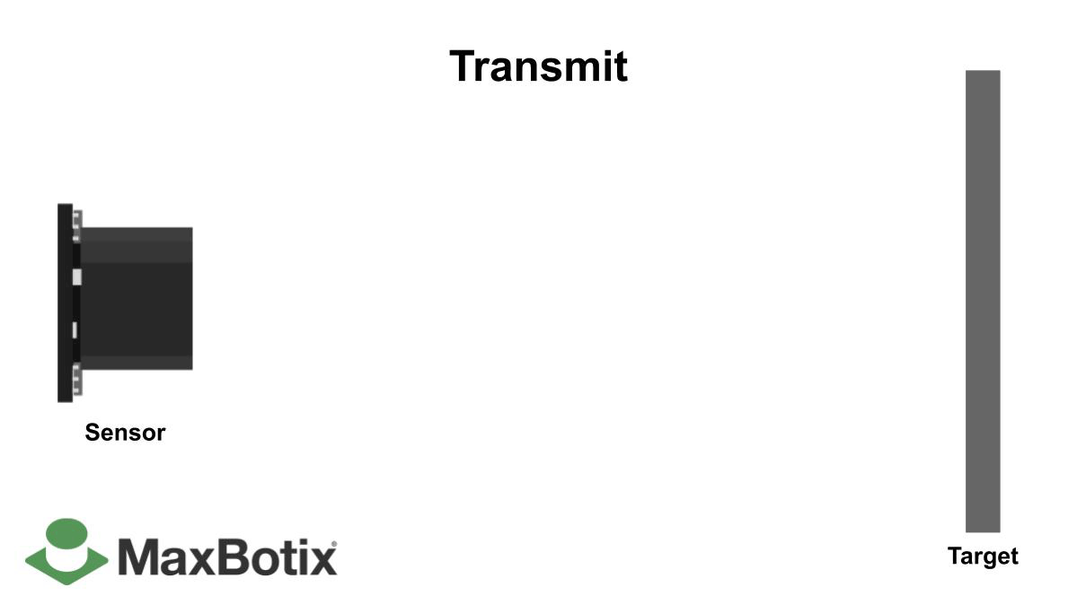
Model Concept
Ultrasonic Sensor:
This is a contactless measurement sensor. It can measure distance up to 2cm – 400cm.
Its accuracy is about three millimeters which is very efficient in water level and
depth measurement applications.

Slide 12
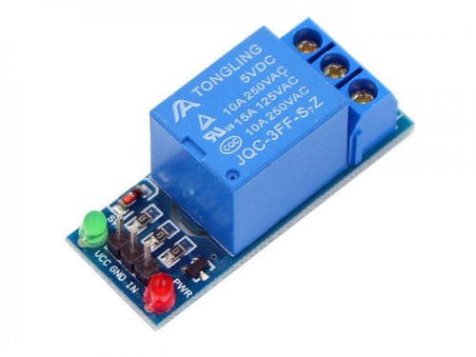
Relay module: A power relay module is an electrical switch that is operated by an electromagnet. The electromagnet is activated by a separate low-power signal from a micro controller. When activated, the electromagnet pulls to either open or close an electrical circuit.

Slide 13
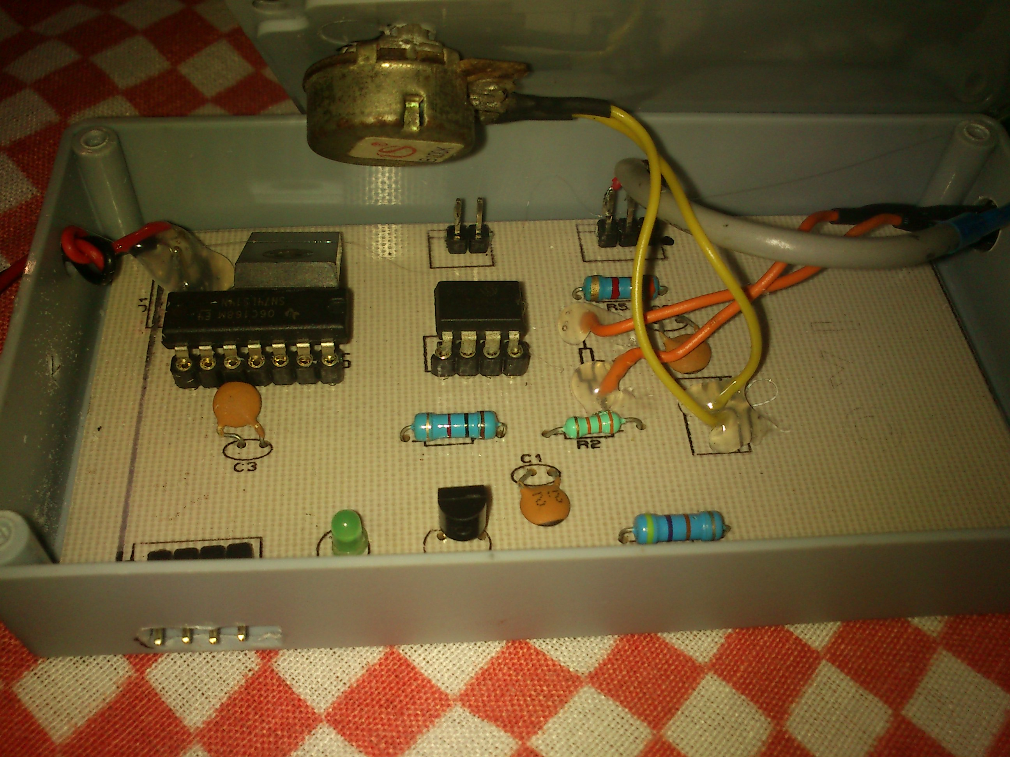
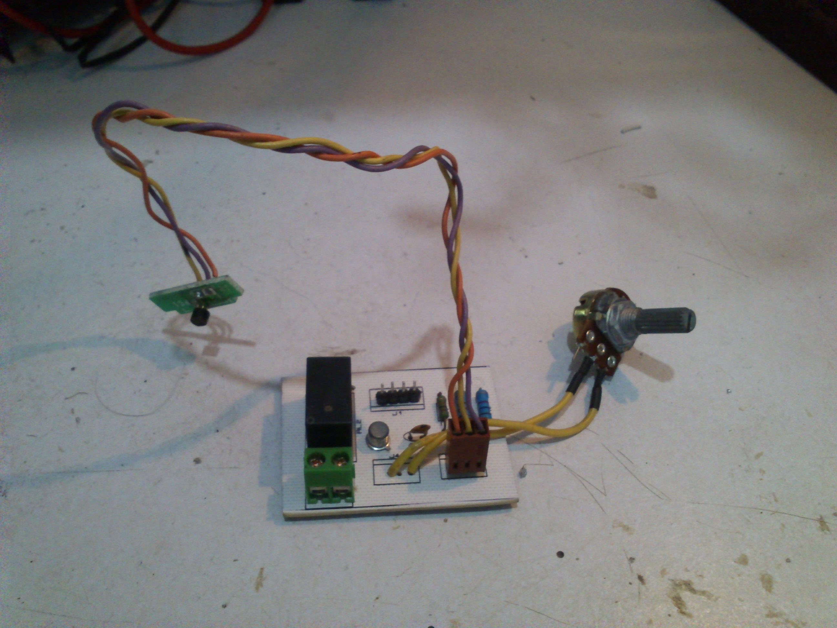
Support Images

Slide 14
Source Code:
The Repository link Is given below;
For further information’s
https://github.com/calvinstarx/SMART-WATER-AND-ELECTICITY-PROJECT.git

Slide 15
Using this you can save the water from wastage in government and residential water tank which is the main moto of our project You don’t need to give your valuable time for the water pump, because it automatically turn off and on as per the level of water.
IMPACT

Slide 16
THANK YOU!
Robo_Trix

